Slide 1
bit.ly/100Aclass
Take a handout, and start looking at the MiamiHeat data frame.

Slide 2
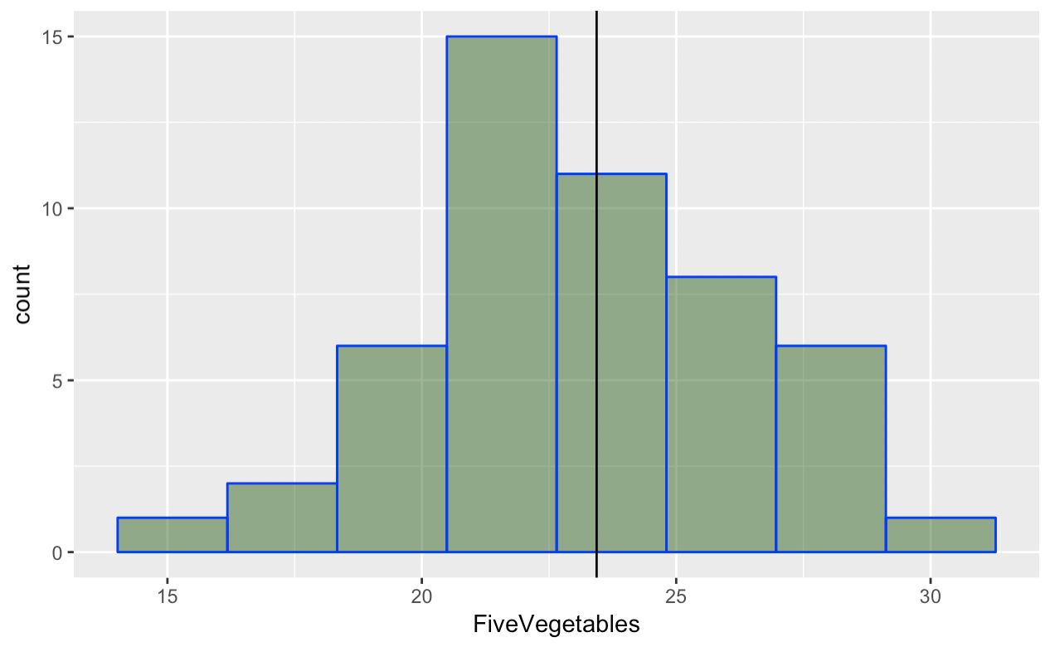
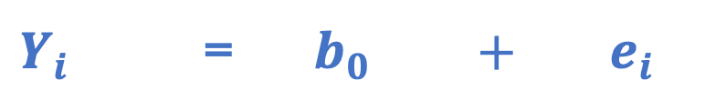
DATA = MODEL + ERROR
Mean = 23
(our simplest
model)
Alabama = 20
Model
Prediction
Also called residual
Alabama 20
Mean 23
Error
-3
=
+
$Y_{i}$ = $b_{0} + e_{i}$
Every data point can be partitioned into model + error.

Slide 3
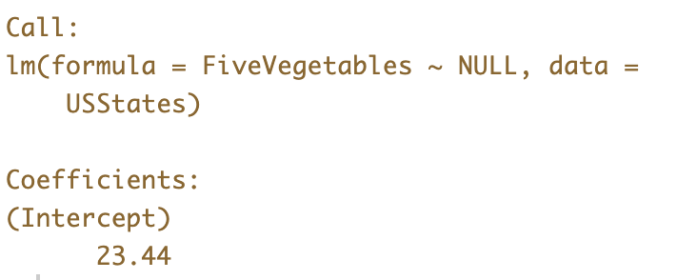
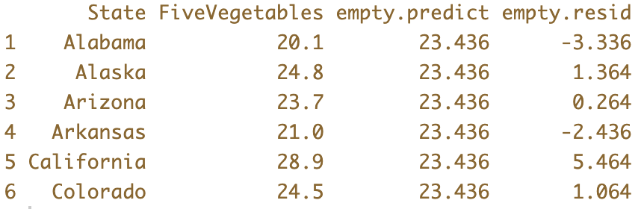
Last Week
lm()
predict()
resid()
Using the mean as the model

Slide 4

Notation
What GLM notation would you use to represent the numbers inside the rectangle?

Slide 5
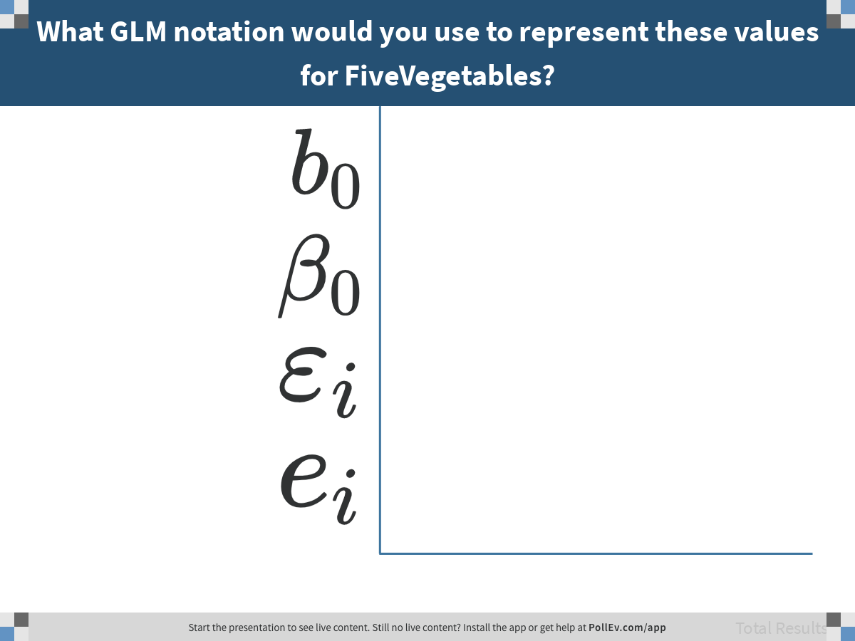
Notes:
What GLM notation would you use to represent these values for FiveVegetables?
https://www.polleverywhere.com/multiple_choice_polls/S5i9EdZNO4t0Nr6IyztLG

Slide 6
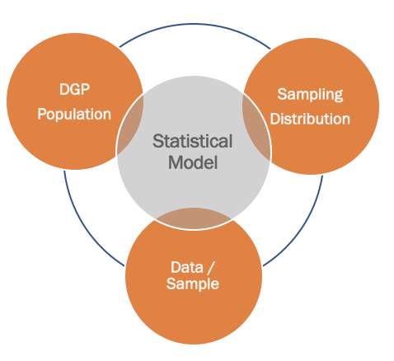
This Week: Focus on Error
Aggregating Error to assess model fit
Modeling the distribution of errors to make predictions

Slide 7
MiamiHeat

Slide 8
The Practice of Data Analysis
Explore Variation
Model Variation
Evaluate Models
Measurement
Sampling
Design
data
MiamiHeat
Tell Your Story
Make Predictions
Notes:
Statistics is the study of variation.
We use variation in data to represent variation in world; try to find out about the DGP.

Slide 9
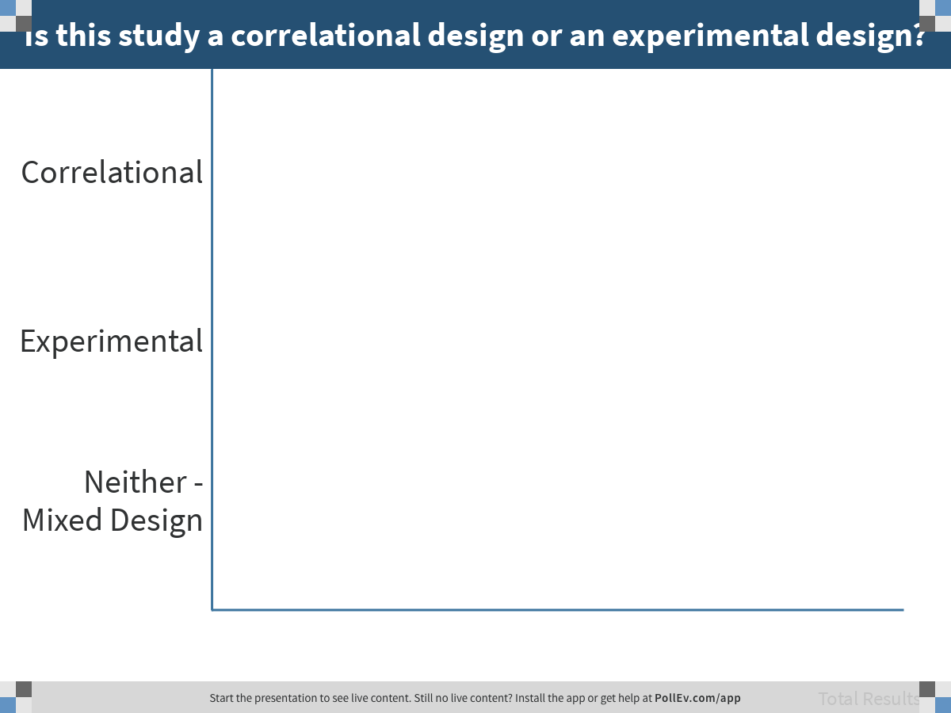
Notes:
Is this study a correlational design or an experimental design?
https://www.polleverywhere.com/multiple_choice_polls/8f86fo4X1K2GJF146egJd

Slide 10
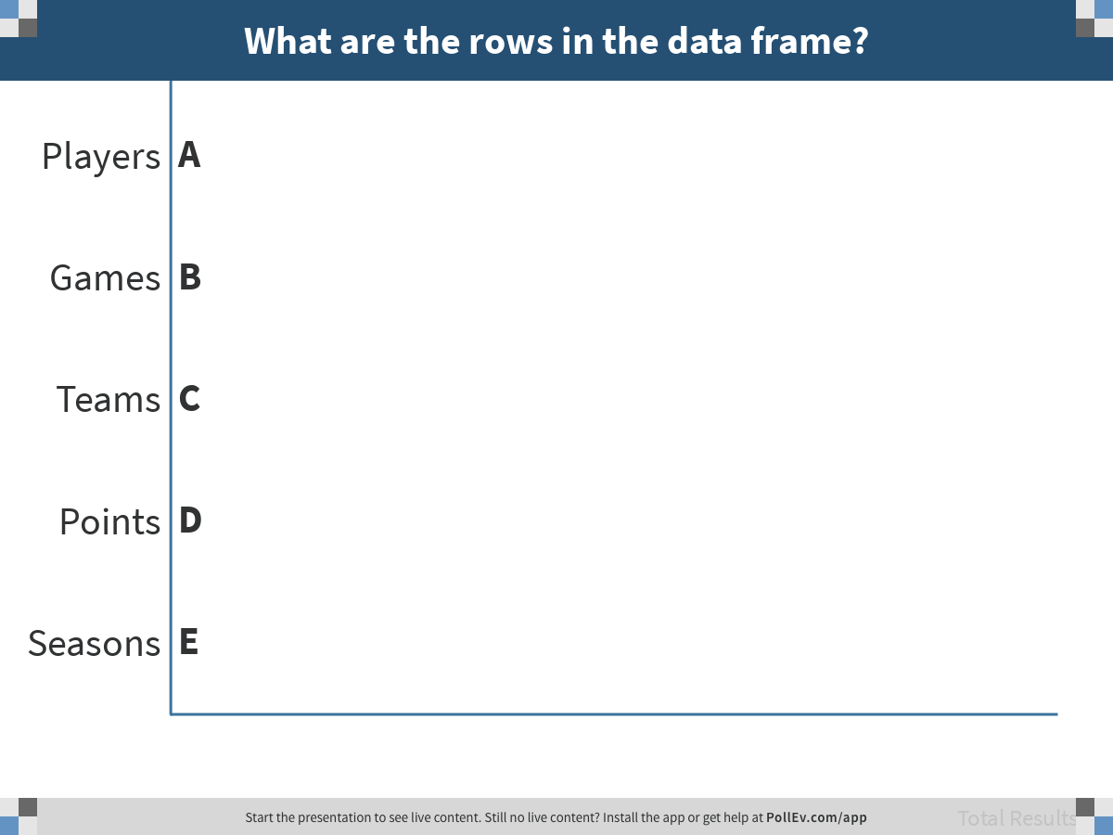
Notes:
What are the rows in the data frame?
https://www.polleverywhere.com/multiple_choice_polls/bxDwTIACPZ9nCq1hwuoXJ

Slide 11
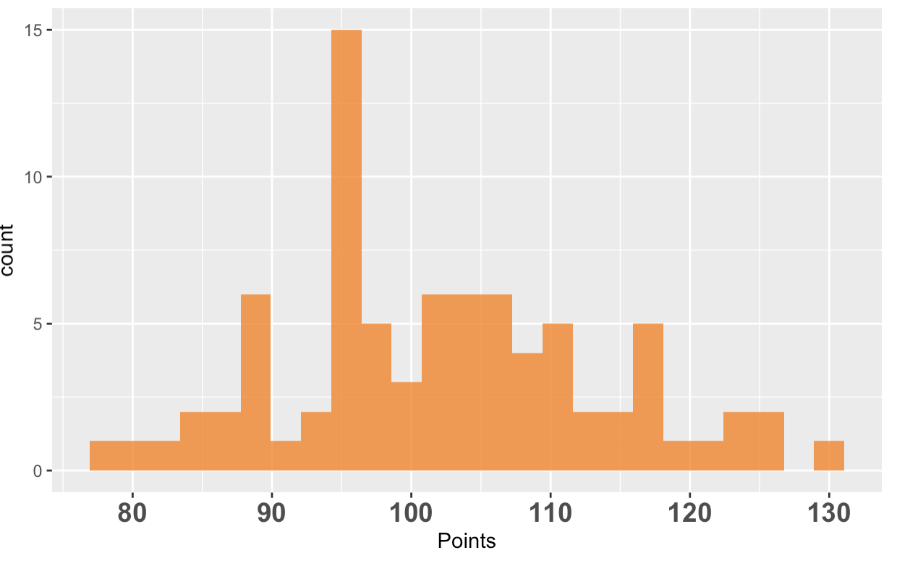
Let’s use Points as the outcome variable
Variation
Where’s the variation in points? Gesture.
Where’s the variation in games? Gesture.
Notes:
Where does this fit into the California example?

Slide 12
Using Points as the outcome variable
Write a word equation for a model to explore with an explanatory variable of your choice.
Points = …
Notes:
Where does this fit into the California example?

Slide 13
Using Points as the outcome variable
Explore the relationship graphically: does your explanatory variable appear to explain variation in points?
scatterplot, faceted histogram, boxplot
Post your graph on the Padlet at the bottom of bit.ly/100Aclass
Notes:
Where does this fit into the California example?

Slide 14
Using Points as the outcome variable
What would the empty/null model be that we would compare to our complex model?
Write as a word equation
Write in GLM notation
Fit the empty model (save the empty model in an object called Empty.model) lm()
Notes:
Where does this fit into the California example?

Slide 15
Example: points = assists + error

Slide 16
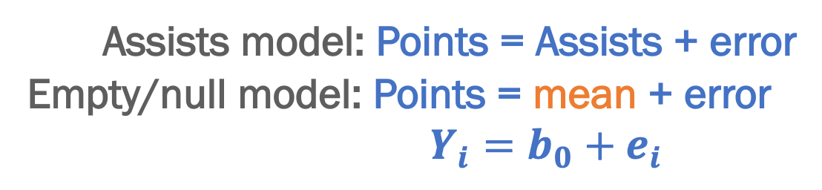
DATA = MODEL + ERROR
points = model + error
location
mean
assists
Assists model: Points = Assists + error
Empty/null model: Points = mean + error
$Y_{i}=b_{0}+e_{i}$
What is the mean here the mean of ?
Notes:
Where does this fit into the California example?

Slide 17
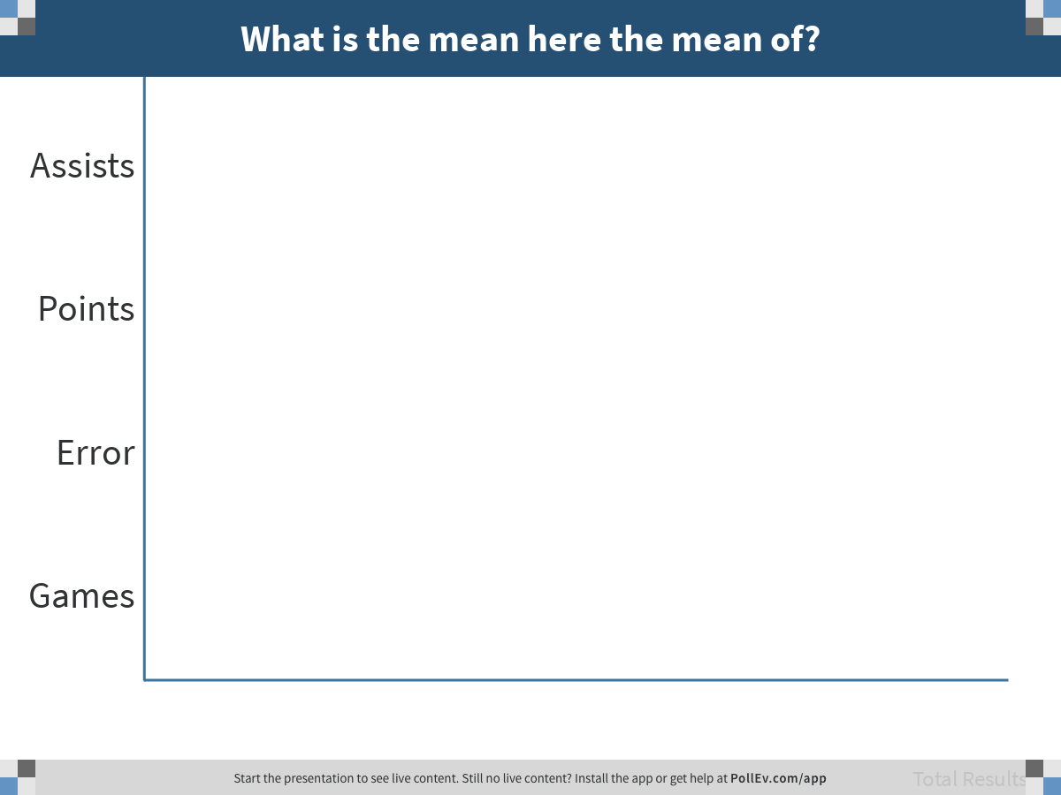
Notes:
What is the mean here the mean of?
https://www.polleverywhere.com/multiple_choice_polls/LnoZMAaLIaT8tjyJ8sIyR

Slide 18
DATA = MODEL + ERROR
points = model + error
location
mean
assists
We are always modeling variation in the outcome variable.
mean of points
Notes:
Where does this fit into the California example?

Slide 19
DATA = MODEL + ERROR
points = model + error
location
mean
Explains ?% of error
assists
Explains 0% of error
Explains ?% of error
model + error = 100% of variation in outcome
Notes:
Where does this fit into the California example?

Slide 20
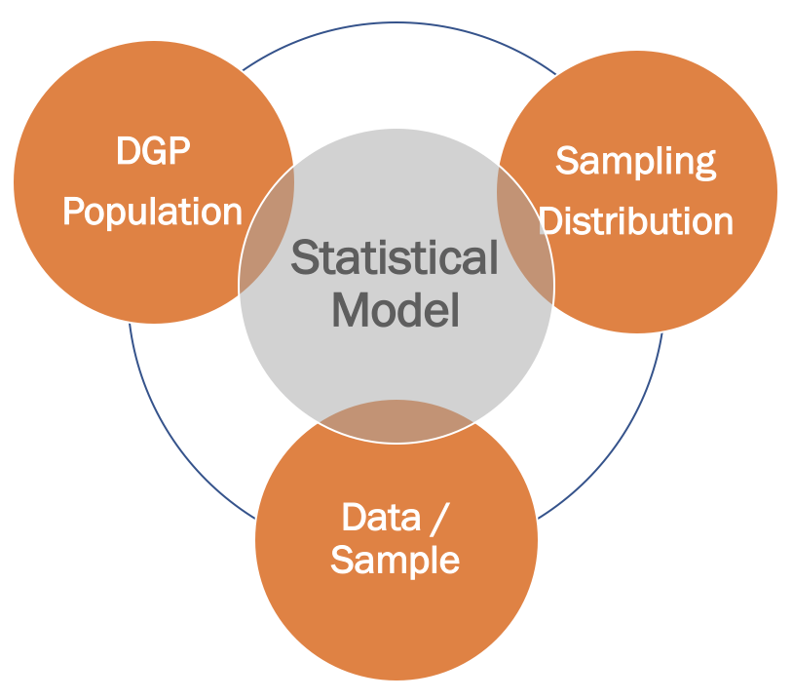

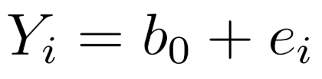
DATA = MODEL + ERROR
Use data to create model of DGP
Notes:
Can’t know exactly the DGP (statistics, only better than nothing)… but we have seen how a random DGP might far… what kind of samples could have been generated from such a process…

Slide 21
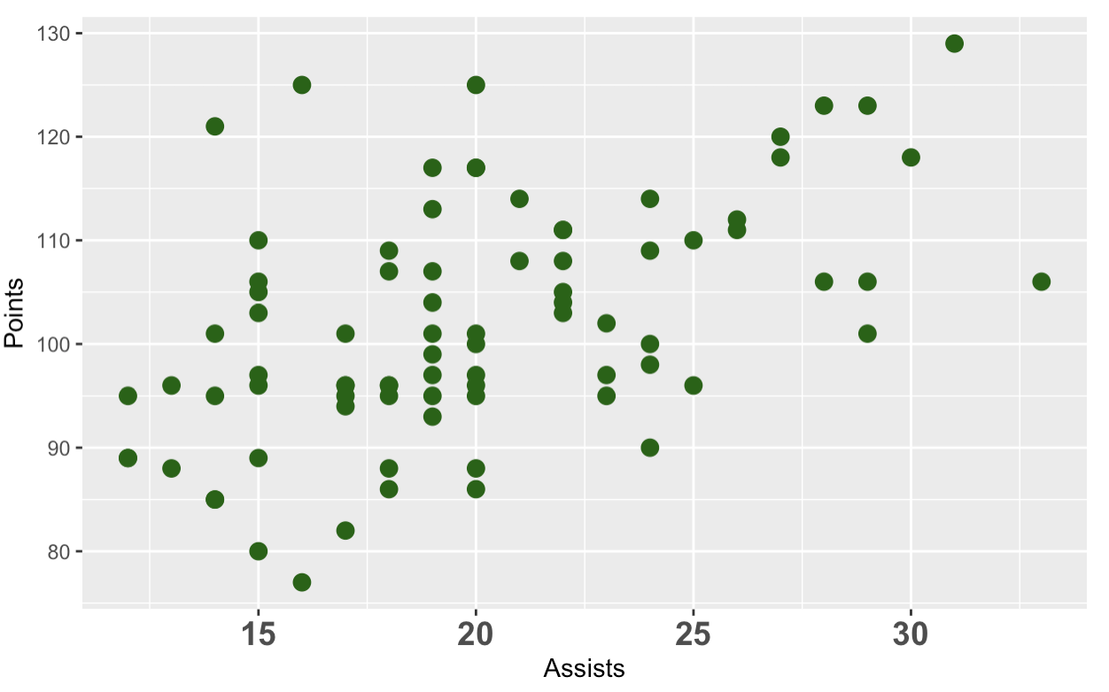
Explaining variation

Slide 22
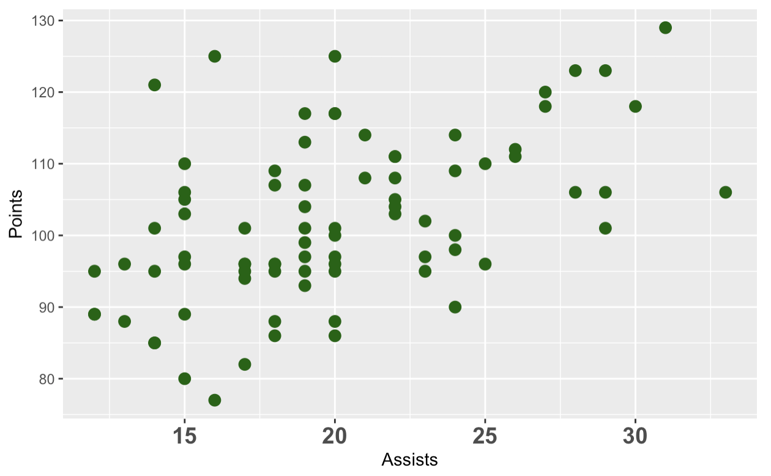
Where is variation in points? Gesture.

Slide 23
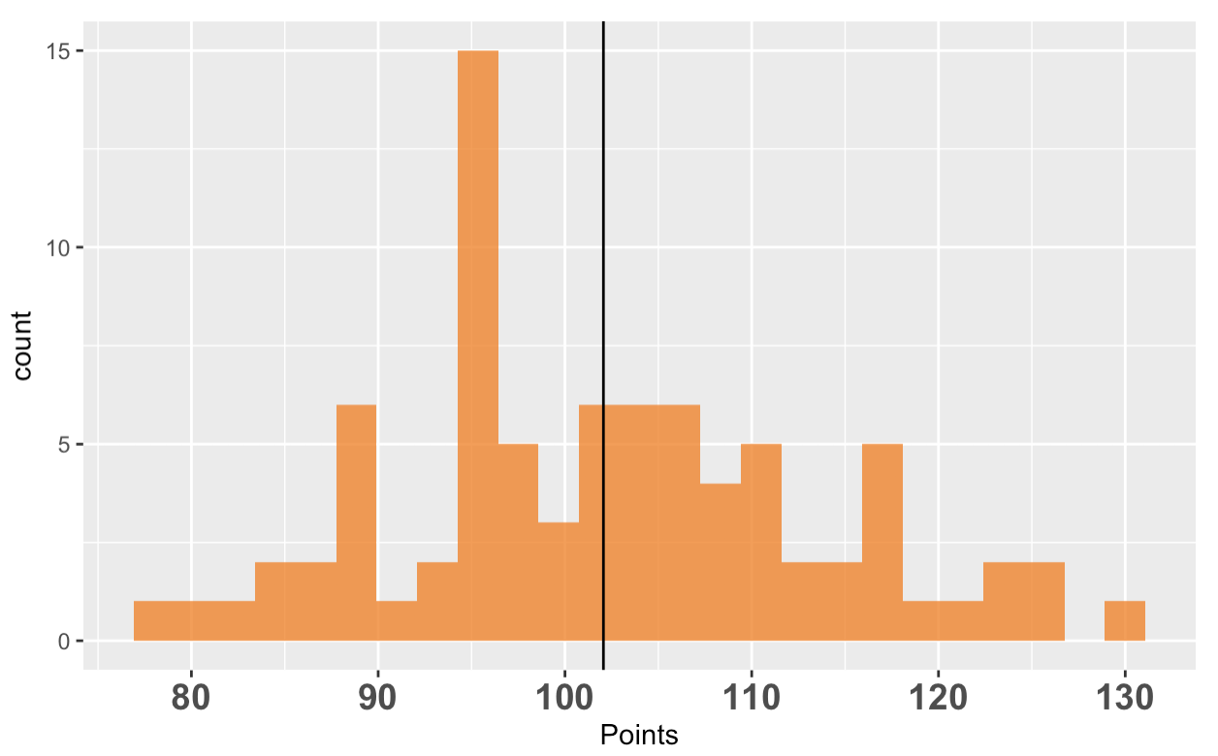
variation in data = model + error
Where is the model? Where is the error?

Slide 24
Where would you draw the empty model on the scatter plot?

Slide 25
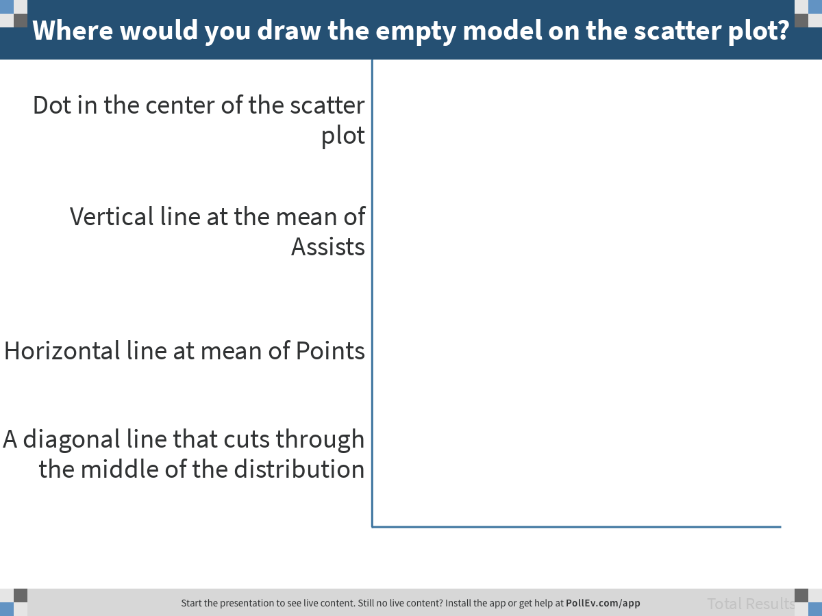
Notes:
Where would you draw the empty model on the scatter plot?
https://www.polleverywhere.com/multiple_choice_polls/eECJmuCMUfRWIXbPUsIpz

Slide 26
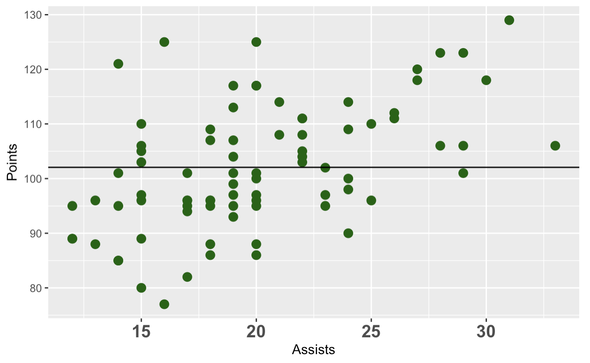
Points = mean + error
Where is the error? Gesture.
Notes:
Error is between mean and points, plus and minus. Discuss the best way to gesture this.

Slide 27
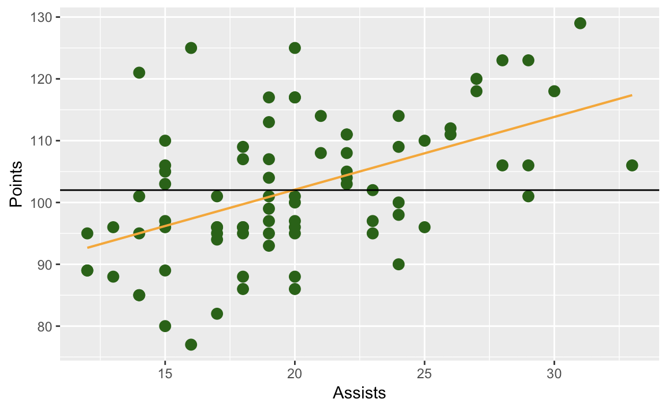
Points = mean + error
Points = Assists + error

Slide 28
Aggregating Error to Indicate Model Fit

Slide 29
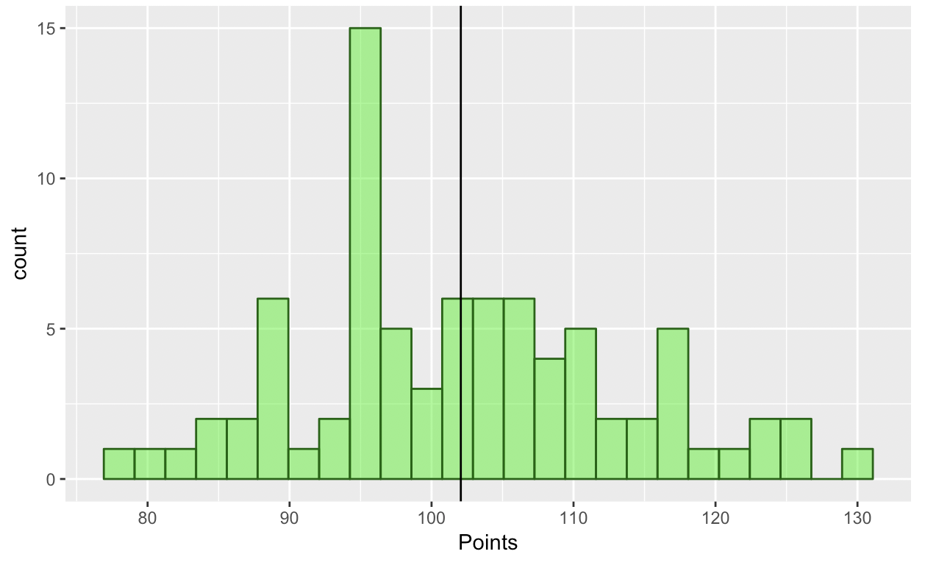
Empty model is a single number
But not just any number

Slide 30
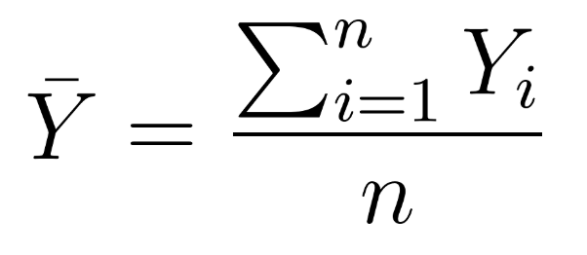
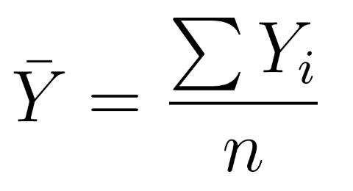
Why the Mean
Mean as an estimator is:
Unbiased
Efficient
Consistent
And: lots of techniques have been worked out using the mean as an estimator [lm() uses mean]
But:
Assumes that errors are distributed normally
And we have new techniques for computational modeling that make it easier to use other estimators (e.g., the median)

Slide 31
“Best fitting” model minimizes total error
What indicator of total error is minimized at the mean?

Slide 32
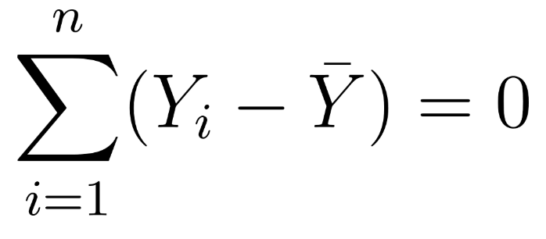
We Cannot Use Sum of Residuals
Fit the empty model to Points and save in Empty.model
Save the residuals from the empty model into a new variable: MiamiHeat$Points.resid
Sum the residuals: sum(MiamiHeat$Points.resid)
Notes:
Where does this fit into the California example?

Slide 33
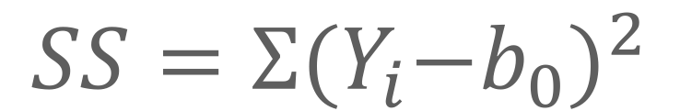
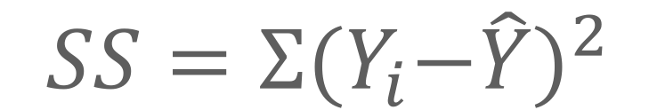
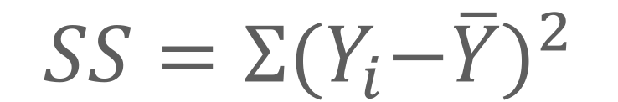
Sum of Squares
$$SS=Σ{{(Y}_{i}−\overline{Y})}^{2}$$
$$SS=Σ{{(Y}_{i}−b_{0})}^{2}$$
$$SS=Σ{{(Y}_{i}−\hat{Y})}^{2}$$
$SS=Σ(Y_{i}−\overline{Y})$ $(Y_{i}−\overline{Y})$
Extremely important concept – learn to spot it!

Slide 34
Challenge: How many methods can you find to use R to calculate SSE for Points?

Slide 35
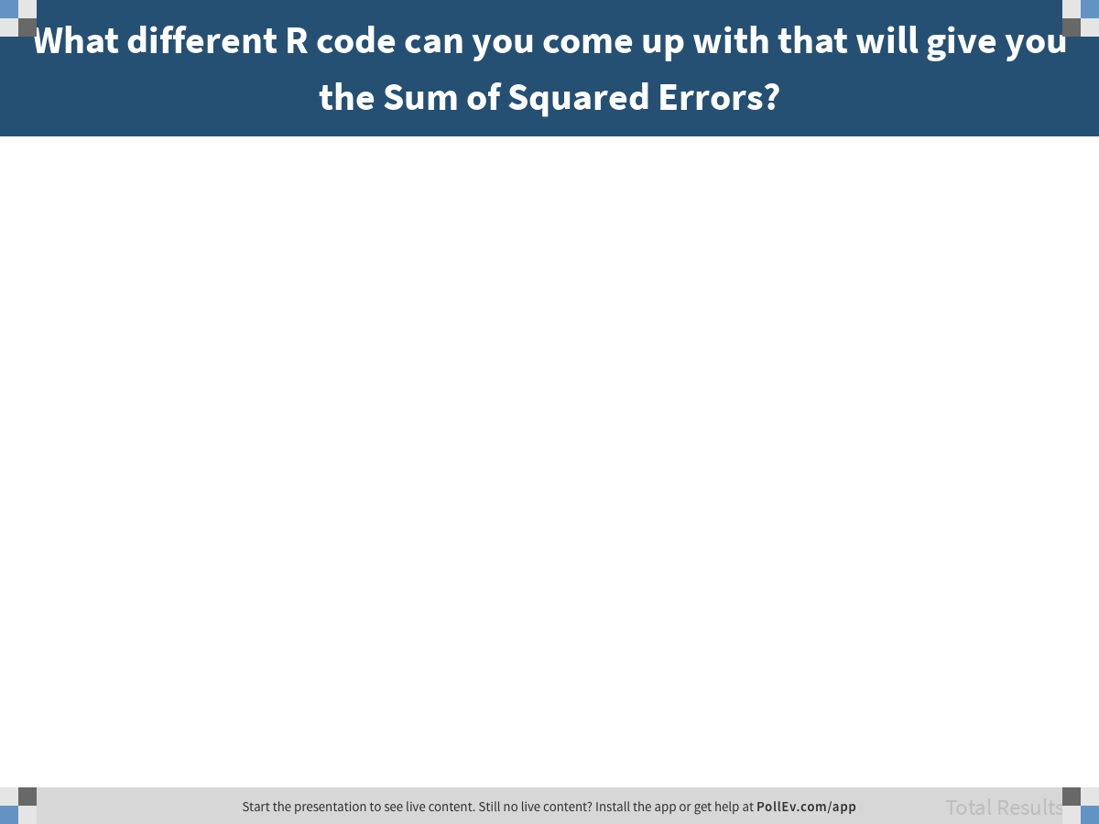
Notes:
What different R code can you come up with that will give you the Sum of Squared Errors?
https://www.polleverywhere.com/free_text_polls/5vA9ZKs8WwZNwDGU9GoZ8

Slide 36
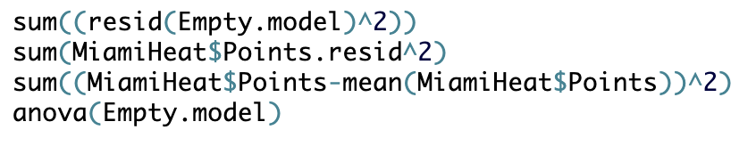
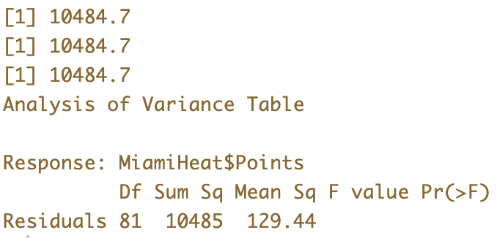
Calculating Sum of Squares

Slide 37
Confirm: Is SSE really smallest at the mean?
SSE at Mean was 10,485.
Calculate SSE for other possible models
Start with 102.06
Try other numbers between 99 and 105
--- Mean =
102.06
sum((MiamiHeat$Points-102.06)^2)
Enter your findings at:
bit.ly/100ASSE
Use this code!

Slide 38
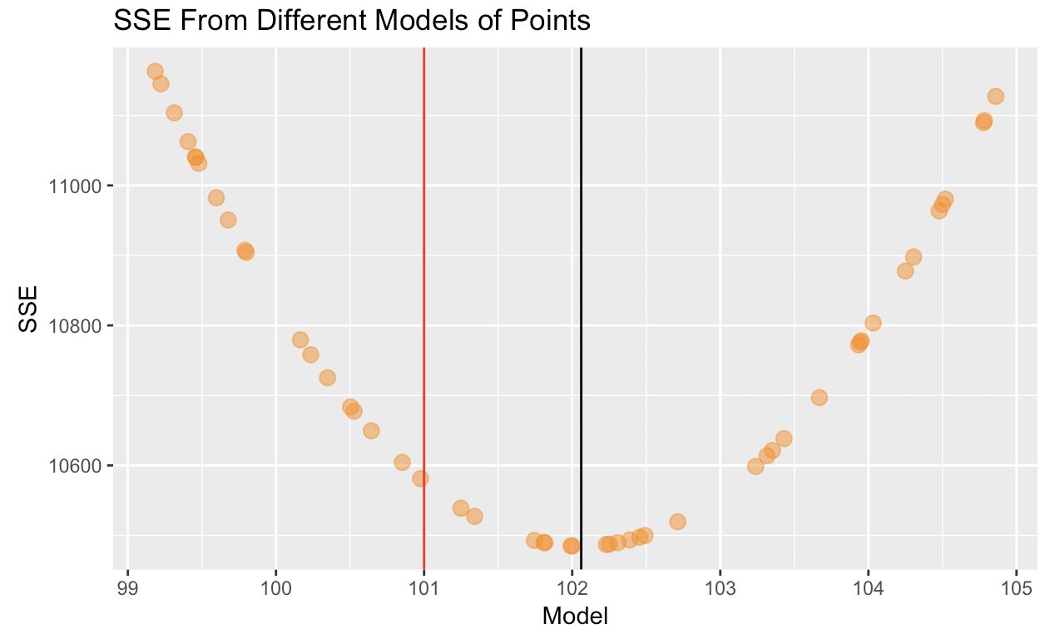
Sum of Squared Errors (SSE)

Slide 39
Try another indicator of total error: Sum of Aboslute Errors (SAE)
SSE at Mean was 10,485.
Calculate SSE for other possible models
Start with 102.06
Try other numbers between 99 and 105
--- Mean =
102.06
sum(abs(MiamiHeat$Points-102.06))
Enter your findings at:
bit.ly/100ASAE
Use this code!

Slide 40
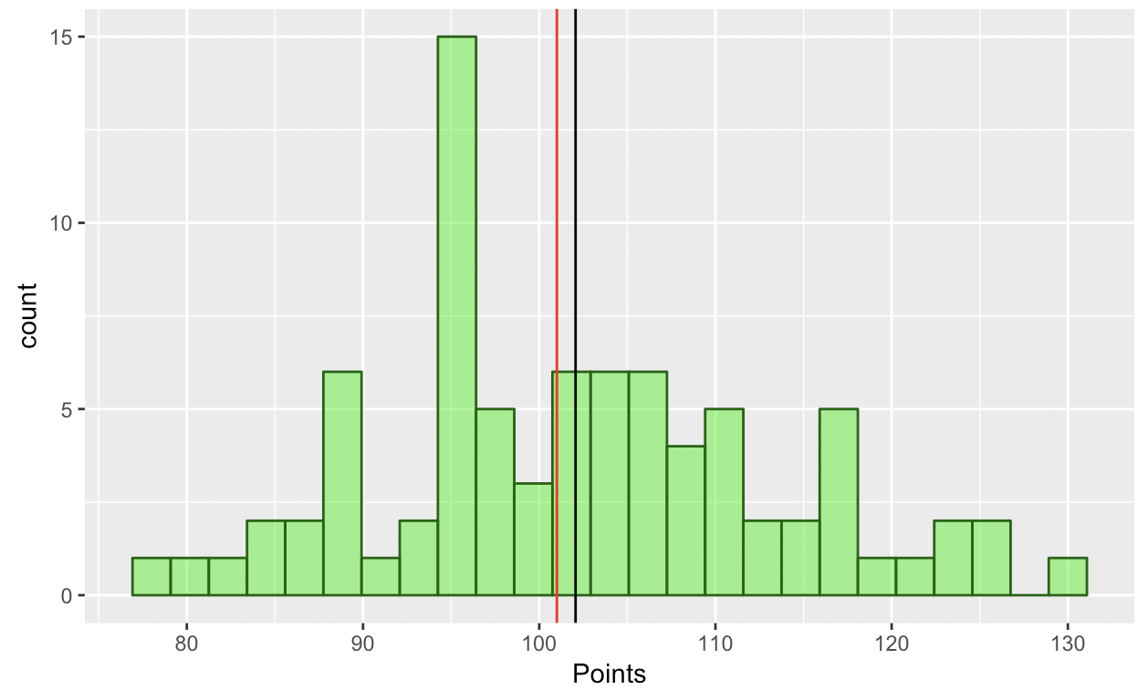
--- Mean = 102.06
--- Median = 101

Slide 41
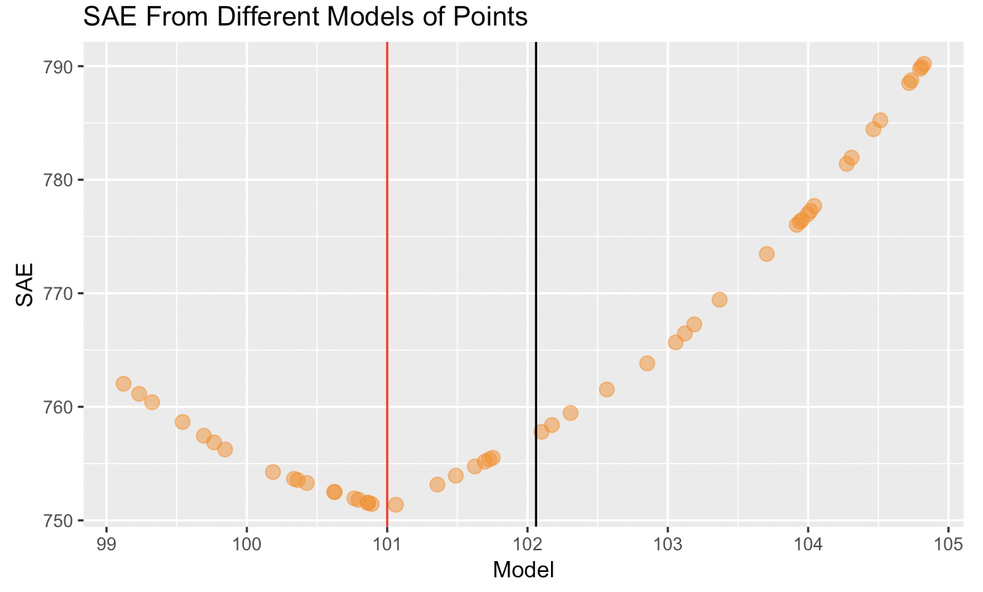
Sum of Absolute Errors (SAE)

Slide 42
SSE is minimized at the mean. No other number will produce a lower Sum of Squares than the mean of the distribution. SAE is minimized at the median.
Notes:
Where does this fit into the California example?

